Slide 1
Thomas Jefferson
Spartans
Sports
Parent Meeting

Slide 2
TJ Athletics purpose
We believe that empowering youth to become the best version of themselves will have a positive impact on society.
The purpose of education-based athletics at TJ is to provide opportunities for students to grow in leadership, self-awareness, respect, responsibility, healthy competition, lifelong fitness, and other positive disciplines.
Dedication, practice and hard work are principles that apply on the field, on the court, in the classroom and in life.
When students leave TJ they are better students, athletes, and people.
Message from CHSAA:
https://www.youtube.com/watch?v=WqdW8LVoqGo

Slide 3
Expectations
Academics
Student-Athletes
Student comes first
Sportsmanship
Cheer for our team, support our team, win and lose with class
NO Hazing/Bullying
Positive player, playing and coaching environment
Character
Leadership
Relationships
Teamwork

Slide 4
Communication with Parents and Athletes
Team Meeting – coaches set and communicate with team
to go over rules, expectations, schedules, concussion and injury protocol
Player/Parent/Coach Agreement
If there is a Concern/Problem
Assuming Positive Intentions – we are all in this for the right reasons
AD will not talk about playing time
What you can expect from me:
Athlete meet/talk with coach first
Athlete meet/talk with coach and parent
Athlete meet/talk with coach, parent, and AD
COMMUNICATION is CRITICAL
24 Hour Rule
Please allow for 24 hours to elapse when requesting a meeting or communication from or with a coach.

Slide 5
REGISTRATION & athletic golden ticket
Family ID – Online Registration System
https://www.familyid.com/organizations/thomas-jefferson
Hard copy of Physical MUST be handed to Athletics
School Based Health Clinic
Free for All DPS Students
King Soopers, Walgreens, Urgent Care
Pay to Play – pay on-line
either $60 or $10 if student is on free/reduced lunch
player must have proof of being a free/reduced lunch student
Emergency Information (back of Golden Ticket)
ATHLETES MUST COMPLETE THEIR ONLINE REGISTRATION, P2P, PHYSICAL, & BE ISSUED A GOLDEN TICKET BEFORE THEY CAN TRYOUT, PRACTICE, OR BE ON THE FIELD/COURT/POOL

Slide 6
Transfer/Non-TJ/Exchange Students
Make sure AD is aware of all transfer, homeschooled, non-TJ, and exchange students
Additional paperwork will be necessary.
Not allowed to play (can practice) until cleared by CHSAA

Slide 7
DPS/TJ Eligibility
Eligibility is weekly (Monday to Saturday)
If a student is ineligible for the week (has 2 F’s reported for the week – some sports may have stricter guidelines and parents will be notified at parent meeting) they cannot play in games for the week and must report to Office Hours on Wednesday from 2:15 – 3:00 with their teacher(s)
Student eligibility status will be changed only if:
A teacher has made a mistake, the posted grade was inaccurate.
If a student has an excused absence and makes up missed work within the school approved guidelines for submission of that make up work. (i.e. student has excused absence on Friday and missed a test, then makes up test on Monday)
All changes must be made by 8:00am Wednesday, and is the responsibility of the student to facilitate
Student-Athlete MUST be cleared by AD to regain eligibility.

Slide 8
Cut vs Non-Cut Note: Seniors Can only Play varsity and are subject to cuts
NON-CUT SPORTS
Fall
Cross Country
Football
Boys Tennis
Gymnastics
Boys Golf
Winter
Girls Swimming
Wrestling
Spring
Girls Tennis
Track & Field
Boys Swimming
CUT SPORTS –depends on numbers
Fall
Boys Soccer
Softball
Volleyball
Winter
Girls Basketball
Boys Basketball
Spring
Baseball
Boys Lacrosse
Girls Soccer
Spirit Teams
Cheer

Slide 9
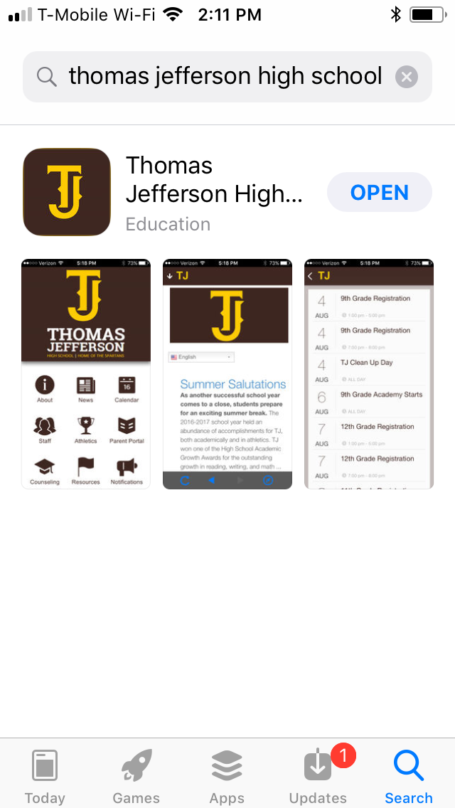
Schedules
DOWNLOAD THE TJ APP!
OR, go to www.tjhs.dpsk12.org/
Click Athletics & Activities
Select Athletic Event Schedules
Schedules will be updated here
Tryouts/Practices
November 10th

Slide 10
Injuries
Certified Athletic Trainer
Scott Thomas: scott_thomas@dpsk12.org
Injury Report and Follow-up
If student-athlete is injured at practice/game they will need to get clearance from trainer
If they come to practice with doctors note, be sure they communicate with trainer before practicing
Concussions
Progressive Return to Play once cleared by physician
When in doubt, sit them out

Slide 11
Meet THE COACHES
Visit http://tjhs.dpsk12.org/athletics-home-2/
click on “Coaches Information” link
THANK YOU!
Follow us on Facebook: Thomas Jefferson Athletics
Follow us on Twitter: @TJSpartans
Visit our website: http://tjhs.dpsk12.org/
#SpartanStrong

